Slide 1

Sakshya: An IoT-Based Smart Wearable for Women’s Safety
When Every Second Counts, We Respond… Because Safety Shouldn’t Wait for Help
(Team Members) Utkarsh Misra (2448370)
Priangshu Paul (2448384)
Shristy Das (2448359)
Umang Adesara (2448389)
Department of Computer Science
4 MDS A & B Academic Year 2025-26

Slide 2

Contents:
Introduction
Problem Statement
Aim and Objectives
Methodology
Architectural Design
Expected Output
Comparison with Existing Systems
Conclusion

Slide 3
Introduction
Growing Concern: Women's safety remains a significant global issue.
Current solutions are flawed:
Existing apps and panic buttons often fail because they require manual activation, which isn't always possible in a real emergency.
Many devices are prone to false alarms, causing unnecessary panic and reducing user trust.
A New Approach with IoT & Edge AI: We can build a smart wearable that automatically and accurately detects real threats. This ensures a quick and reliable response when it is most needed, providing dependable protection.

Slide 4
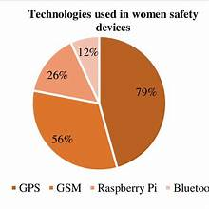
Tech used women's safety devices.
GPS: 79%
GSM: 56%
Raspberry Pi: 26%
Bluetooth: 12%

Slide 5
Problem Statement
The Core Challenges in Women's Safety Devices
Manual Activation is Unreliable: In genuine emergencies, a person under attack may be unable to manually trigger an alert.
High Rate of False Alarms: Existing systems frequently generate false alarms, which leads to user frustration and a lack of trust in the device.
Lack of Intelligent & Swift Response: Current solutions do not offer real-time, intelligent threat detection and a verified, quick response system.
Our Goal: To design a smart wearable that can autonomously detect real danger, minimize false activations, and ensure that rapid help is on the way.

Slide 6
Aim & Objectives
Aim: To develop Sakshya, an IoT-enabled smart wearable device that ensures real-time, reliable women’s safety by intelligently detecting genuine threats, reducing false alarms, and providing instant automated assistance and self-defense mechanisms.
Objectives:
Multi-sensor IoT Integration – Monitor motion, environmental sounds, and vital signs for early threat detection.
AI-Based Threat Analysis – Identify real danger while minimizing false alarms.

Slide 7
Objectives Continued...
Non-Lethal Self-Defense – Activate strobe lights, loud alarms, and dye spray to disorient and identify attackers.
Discreet User Control—Provide manual override to prevent accidental activation.
Performance Evaluation – Benchmark against existing wearables to prove improved accuracy, safety, and effectiveness.
Automated Emergency Response—Trigger SOS alerts with location, live audio/video, and instant police notification.

Slide 8
Methodology
Data Collection: Multi-sensor monitoring (motion, vitals, GPS, environment) via Arduino Continuous real-time data acquisition from gyroscope, accelerometer, heart rate, and temperature sensors
Threat Analysis: Real-time pattern recognition and AI-based risk assessment Advanced algorithms process sensor fusion data to identify potential danger situations and anomalies
Decision Layer: Automated threat classification with context-aware filtering The intelligent system evaluates threat severity and minimizes false alarms through multi-parameter validation
Emergency Response: Dual alerts (light + sound) with GPS location sharing Immediate activation of strong light and loud alarm while transmitting location to emergency contacts
User Control: Manual override button and customizable sensitivity settings Direct user activation capability with personalized threshold adjustments for different environments

Slide 9

Architectural Design
Overall Architecture of the Sakshya Smart Wearable

Slide 10
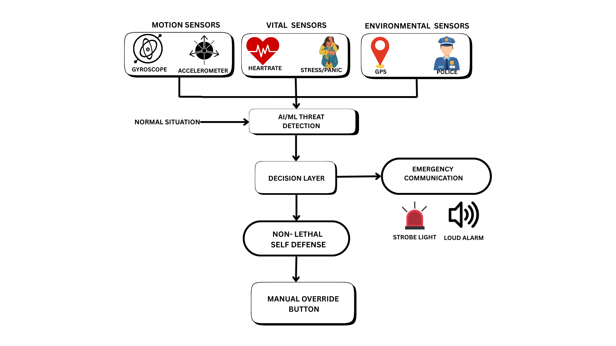
Architectural Design
Overall System Design/Workflow of the Sakshya Smart Wearable

Slide 11
Expected Outcome
The development of Sakshya is not just about creating another safety device; it's about engineering a paradigm shift in personal security. Our expected outcomes focus on delivering a system that is intelligent, reliable, and proactive, directly addressing the failures of current products.
Drastically Reduced False Alarms
Achieve an accuracy rate of over 95% in threat detection.
Eliminate the "cry wolf" effect to build user and responder trust.
Ensure alerts are treated with genuine urgency.
Fully Autonomous & Instant Emergency Response
Provide a seamless, hands-free safety net.
Automatically transmit live GPS, audio, and video evidence.
Remove the burden of action from the user during a crisis.
Active, On-the-Spot Deterrent Mechanism
Proactively intervene, not just passively alert.
Deploy non-lethal defenses: strobe light, alarm, and dye marker.
Create a critical window of opportunity for escape.
Enhanced User Confidence and Freedom
Empower women with a reliable and proactive safety tool.
Reduce fear and anxiety in daily life.
Provide true peace of mind with a dependable guardian.

Slide 12
Comparison with Existing Systems
Feature | Existing Systems (e.g., invi Bracelet, Leaf Wearables, Panic Apps) | Sakshya (Our Proposed System)
Activation Method | Manual Only: Requires a distinct user action like a double-press, long-press, or pulling a pin. Often difficult during a struggle. | Autonomous & Manual: AI-driven automatic activation based on verified threats, with a discreet manual override for user control.
Threat Detection | None or Simplistic: Relies on a simple button press. Some may have basic fall detection, but no contextual threat analysis. | Intelligent Fusion: Uses AI to analyze combined data from motion, vital, and audio sensors to understand context and verify real threats.
False Alarm Rate | High: Prone to accidental button presses in a pocket or during daily activities, leading to user distrust. | Extremely Low: AI analysis and a silent user confirmation window filter out false positives, ensuring high reliability.
Emergency Response | Passive & Limited: Sends a pre-written SMS with a GPS link to a small, predefined list of personal contacts. | Active & Comprehensive: Sends live GPS tracking, streams audio/video evidence to contacts and authorities, and initiates a multi-stage alert.
Self-Defense | Minimal to None: Some devices may include a loud audible siren, but offer no other form of active deterrent. | Integrated & Non-Lethal: Actively deters attackers with a multi-modal response: a disorienting strobe light, loud alarm, and smart dye spray.
"Smart" Capability | Basic Connectivity: Limited to Bluetooth pairing with a phone, GPS for location, and GSM for sending texts. | True Intelligence: Employs adaptive AI that learns user behavior and uses context-awareness (time, location) to improve accuracy.

Slide 13
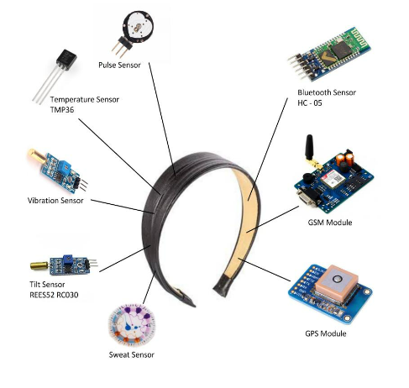
An existing device for women's safety comprised of different sensors:
Temperature sensor
Pulse sensor
Vibration sensor
Tilt Sensor
Sweat sensor
GPS module
GSM module
Bluetooth Sensor

Slide 14
Conclusion
Revolutionary Safety Solution: Sakshya Smart Wearable represents a breakthrough in personal safety technology, combining multiple sensors with AI-driven threat detection to provide comprehensive protection for users
Intelligent Response System: Advanced decision-making algorithms ensure accurate threat assessment. Real-time processing minimizes false alarms while maximizing response effectiveness in genuine emergencies
User-Centric Design: Seamless integration of automated protection with manual user control Customizable settings and override capabilities provide users with complete control over their safety device
Future Impact: This wearable technology has the potential to transform the personal security landscape. Scalable design allows for widespread adoption and integration with emergency services infrastructure

Slide 15
Thank you

